Slide 1

Bilingualism
Chapter 5

Slide 2

Bilingualism/Multilingualism
BI – speaking two languages fluently.
MULTI – speaking three or more languages fluently

Slide 3
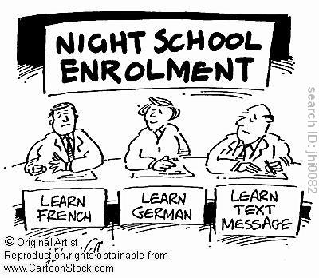
Bilingualism/Multilingualism
What exactly is fluency?
How would you define fluency?

Slide 4
Bilingualism/Multilingualism
Productive bilinguals can speak and understand both languages
Receptive bilinguals can understand both languages but have limited production abilities

Slide 5
Language Definitions
L1 – language that is learned first
L2 – language that is learned second

Slide 6
Language Definitions
Simultaneous – L1 and L2 are learned together at the same time
Early sequential – L1 learned first, L2 learned relatively early in childhood
Late sequential – L1 learned first, L2 learned later in adolescence and onwards

Slide 7
Language Definitions
Which language do people speak?
Depends on culture
Who you are talking to
What the national language is

Slide 8
Questions
What is the best way to teach a second language?
How do we store the two languages in our lexicon?
How do we translate between the two languages?

Slide 9
Early research
Diary studies of people who’ve moved as children – picked up and switched to new language
Language mixing – when words combine (i.e. putting wrong suffixes on)
Code switching – switching languages mid sentences

Slide 10
Early research
Both languages are learned well, but slower vocabulary development in each individual language (because you are learning two of them!)
Overall it’s a great advantage
More metalinguistic awareness
Cognitive flexibility
Verbal fluency

Slide 11
Lexicon
Separate store model – suggests that there are separate lexicons for each language that connect at the semantic level

Slide 12
Lexicon
Separate store model support
Repetition priming in the same language
If you hear the word DOCTOR in English and then again, you are faster at the second DOCTOR.
If you hear DOCTOR in English and then another language, you are not as fast in the second language.
If they were all stored together, it wouldn’t matter what language you heard each of them in.

Slide 13
Lexicon
Common store models – one lexicon and one semantic memory system, words are connected together.

Slide 14
Lexicon
Common store model support
Semantic priming occurs across both languages
Especially if you force the semantic priming to be an automatic process (masking, fast priming)
Controlled languages processes slow down priming across languages.

Slide 15
Lexicon
Research favors the common store model, BUT
There’s an interaction with age of learning for L2
Later L2 learning appears to lean toward separate stores, much less priming.

Slide 16
Lexicon
Mixed store models – a combination of separate and common stores
Cognates – words in different languages that have developed from the same root (i.e. same Latin root) or are the same word
For example, oblige in English and French
These words tend to act like they are stored the same

Slide 17
Lexicon
The problem with all this research:
Discrimination between languages appears to occur at a low level.
So?
Hard to interpret semantic effects if you are filtering at a perceptual level.

Slide 18
Syntax
Not a lot of research, but some research supports that when syntax is roughly similar (English – Spanish) then you store it as one syntax

Slide 19
Language Switching
Forward translation (L1 to L2) – conceptual mediation – must access the meaning of a word in order to translate it
Backward translation (L2 to L1) – word association – use direct links between items in the lexicon

Slide 20
Language Switching
Semantic factors change your performance for forward but doesn’t help your backward translation
However, congruent pictures help backwards, suggesting some semantic involvement

Slide 21
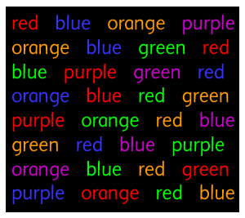
Language Switching
Speaking in target language – only the target language words are considered.
When shown pictures with L2 word labels and asked to name the items in the picture, that other language didn’t interfere (think Stroop task)

Slide 22
Brains
L1 (dominant language) usually appears in the left hemisphere
L2 tends to activate the right hemisphere
Children
The dominant language lateralizes before the non-dominant language.

Slide 23
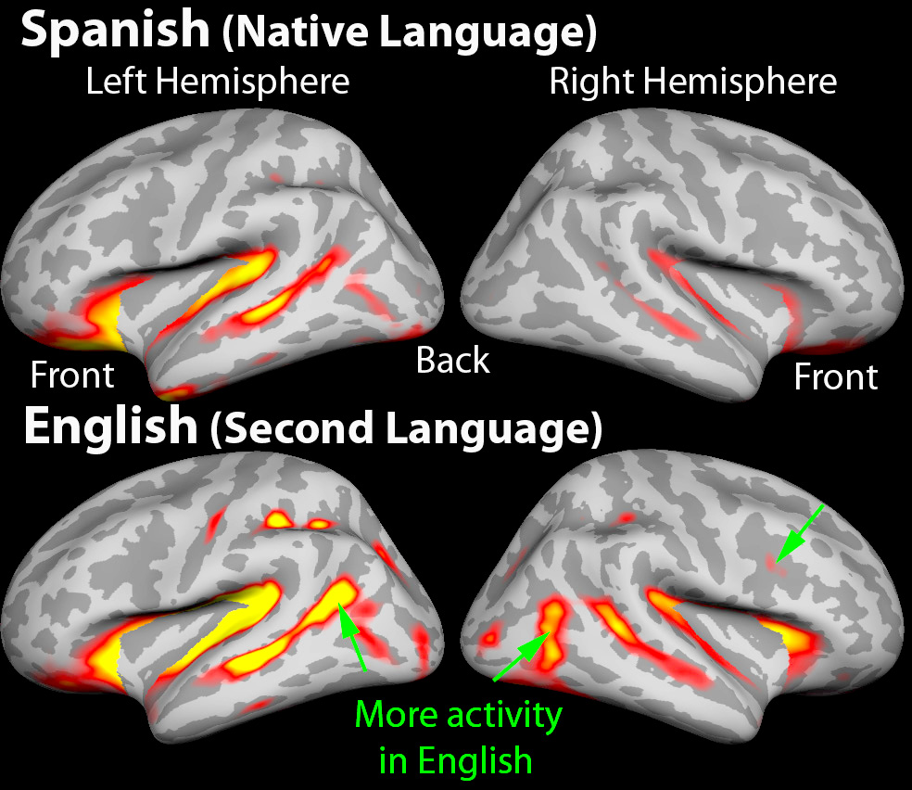

Slide 24

Acquisition
Why you so hard?!

Slide 25
acquisition
Learning syntax or some other language parts is difficult outside the critical period
Less time and motivation
Contrastive Hypothesis – have difficulty learning L2 when L1 does not equal L2
Learning – lot at first, then tapers off, then learn a lot again (restructuring)

Slide 26
Teaching
Traditional method – translation from one language to another, lectures in the primary language (L1)
Direct methods – all teaching is in L2, emphasizing conversational skills

Slide 27
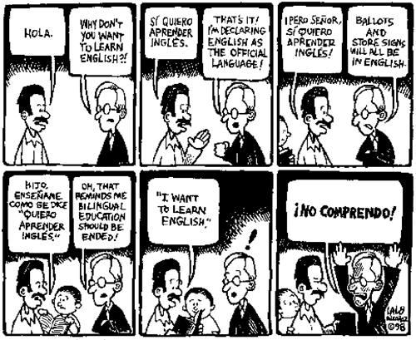

Slide 28
Teaching
Audiolingual method – emphasizes speaking and listening before reading and writing
Immersion method – teaches learners exclusively L2
Submersion method – usually surrounded by L2 speakers (sink or swim)
PICTURE 159

Slide 29
Monitor Model
Language learning versus Language acquisition
Learning emphasizes explicit grammar rules
Acquisition unconscious grammar rule use
Better programs focus on acquisition

Slide 30
Monitor Model Hypotheses
Acquisition and learning distinction – children acquire their first language unconsciously, automatically, they do not learn it.
Adults need to try to acquire a second language but generally focus on learning instead
Natural order in acquisition – syntax errors, generalization rules, are in the same order in both languages (page 160)

Slide 31
Monitor Model Hypotheses
Monitor hypothesis – acquisition processes create sentences in L2 but learning enables us to have mechanisms that check the sentences

Slide 32
Monitor Model Hypotheses
Comprehensible input – emphasizes the role of comprehension, were we understand the meaning and form of the input
Active filter hypothesis – attitude and emotional factors are important

Slide 33
Monitor Model Concerns
Other influences on second language learning:
Phonetic coding ability – the ability to identify new sounds and form associations with them
Grammatical sensitivity – ability to recognize grammatical functions of words and syntactic structures

Slide 34
Monitor Model Concerns
Other influences on second language learning
Rote – learning ability
Inductive learning ability – inferring rules from data
Working memory
Motivation

Slide 35

What can we do?
Immersion seems to work quite well
But also immersion where less is more – so starting with smaller units and building up to larger more complex syntactic pieces

Slide 36
What can we do?
Four Cs (Sharpe)
Communication – must emphasize that people use L2 to communicate
Culture – de-emphasizing direct translation, more about the culture of the language
Context – providing comprehensible input
Confidence

